Slide 1
HUB – SATS Information
08 / 11 / 2019

Slide 2
Overview
Cyber Security

Slide 3





High Level Communications Schema – TIER 1 / TIER 2
SORT_RQST / SORT_RSLT
TOE
T1
T2
T3
T4
Data Protection
T5
Server TIER1
T9
T8
T7
T6
Server TIER2
GTW TIER2
MQ CLIENT
MQ CLIENT
SORT_INST / SORT_ACK

Slide 4

MQ – Data fields from sniffer
Field Name | Description | Symbol
Frame_Time | Timestamp di cattura del pacchetto da parte dello sniffer.
Frame_Time_P | Timestamp di cattura dell pacchetto precedente (stesso VID) da parte dello sniffer.
Frame_Time_DIFF_mill | Differenza con millesimi tra Frame_Time e Frame_Time_Precedente
HDEVTM | Informazione di Timestamp inserito nel pacchetto MQ dal server.
HDEVTM_P | Informazione di Timestamp del messaggio precedente (con stesso VID) inserito nel pacchetto MQ dal server.
HDEVTM_P_mill | Differenza con millesimi tra HDEVTM e HDEVTM_Precedente
T2 | T2 segment calculation time for T2 (Frame_Time – HDEVTM) |  | [2019-11-08: Actually T2 don’t use millisecond, the metric is not usefull]
T6T7 | Segment calculation time for T6 and T7 (Frame_Time – HDEVTM) |  | [2019-11-08: Actually T2 don’t use millisecond, the metric is not usefull]

Slide 5

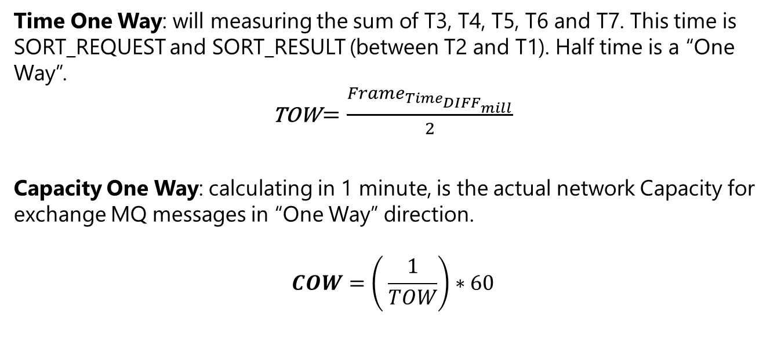
TOW and COW
Time One Way: will measuring the sum of T3, T4, T5, T6 and T7. This time is SORT_REQUEST and SORT_RESULT (between T2 and T1). Half time is a “One Way”.
TOW $=\frac{Frame_{Time_{DIFF_{mill}}}}{2}$
Capacity One Way: calculating in 1 minute, is the actual network Capacity for exchange MQ messages in “One Way” direction.
$$COW=\left( \frac{1}{TOW}\right)∗60$$

